Slide 1
Lecture 7
Deadlocks

Slide 2
Deadlocks
Having two processes using the same file-system table slot will lead to a corrupted file system. Consequently, all operating systems have the ability to (temporarily) grant a process exclusive access to certain resources.
For many applications, a process needs exclusive access to not one resource, but several. Suppose, for example, two processes each want to record a scanned document on a Blu-ray disc. Process A requests permission to use the scanner and is granted it. Process B is programmed differently and requests the Blu-ray recorder first and is also granted it. Now A asks for the Blu-ray recorder, but the request is suspended until B releases it. Unfortunately, instead of releasing the Blu-ray recorder, B asks for the scanner. At this point both processes are blocked and will remain so forever. This situation is called a deadlock.

Slide 3
Resources
We will refer to the objects granted as resources. A resource can be a hardware device (e.g., a Blu-ray drive) or a piece of information (e.g., a record in a database).
Sequence of events required to use a resource:
1. Request the resource.
2. Use the resource.
3. Release the resource.

Slide 4
Resources
Resources come in two types:
preemptable and nonpreemptable.
A preemptable resource is one that can be taken away from the process owning it with no bad effects.
Memory is an example of a preemptable resource.
A nonpreemptable resource is one that cannot be taken away from its current owner without causing failure. If a process has begun to burn a DVD, suddenly taking the DVD copying away from it and giving it to another process will result in a garbled DVD.

Slide 5
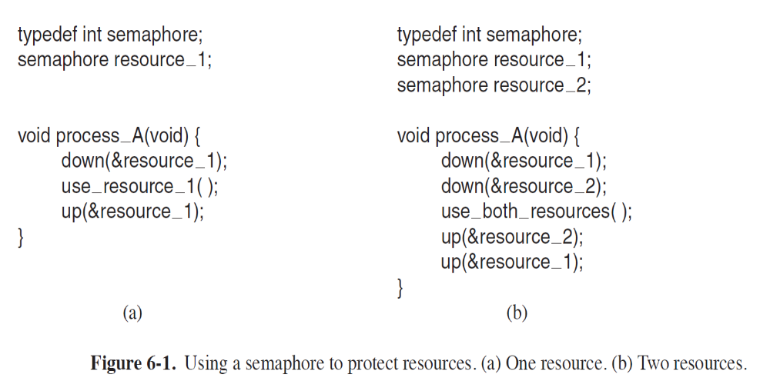
Resource Acquisition

Slide 6
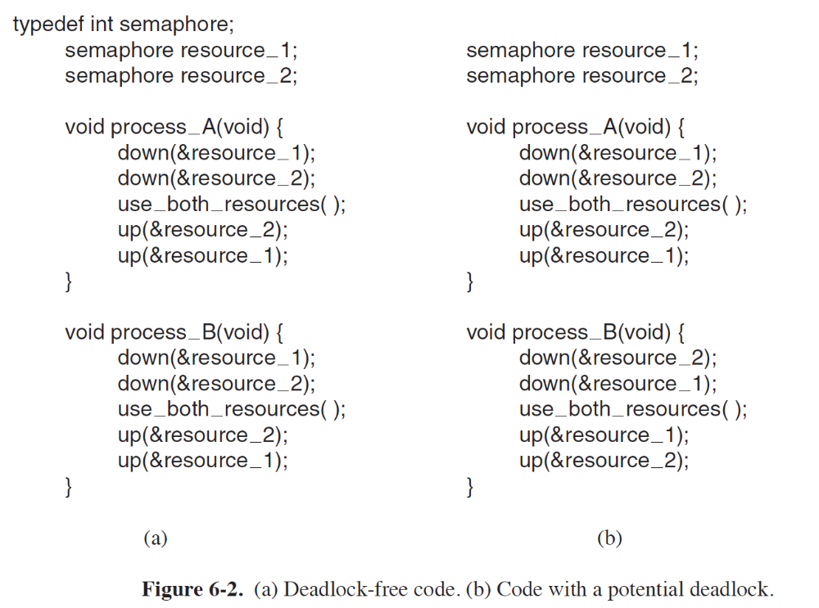
Resource Acquisition

Slide 7
Resource Acquisition
In Fig. 6-2(a), one of the processes will acquire the first resource before the other one. That process will then successfully acquire the second resource and do its work. If the other process attempts to acquire resource 1 before it has been released, the other process will simply block until it becomes available.
In Fig. 6-2(b), the situation is different. It might happen that one of the processes acquires both resources and effectively blocks out the other process until it is done. However, it might also happen that process A acquires resource 1 and process B acquires resource 2. Each one will now block when trying to acquire the other one. Neither process will ever run again. Bad news: this situation is a deadlock.

Slide 8
Introduction to Deadlocks
Deadlock can be defined formally as follows:
A set of processes is deadlocked if each process in the set is waiting for an event that only another process in the set can cause.

Slide 9
Condition for Resource Deadlocks
Four conditions must hold for there to be a (resource) deadlock:
1. Mutual exclusion condition. Each resource is either currently assigned to exactly one process or is available.
2. Hold-and-wait condition. Processes currently holding resources that were granted earlier can request new resources.
3. No-preemption condition. Resources previously granted cannot be forcibly taken away from a process. They must be explicitly released by the process holding them.
4. Circular wait condition. There must be a circular list of two or more processes, each of which is waiting for a resource held by the next member of the chain.

Slide 10
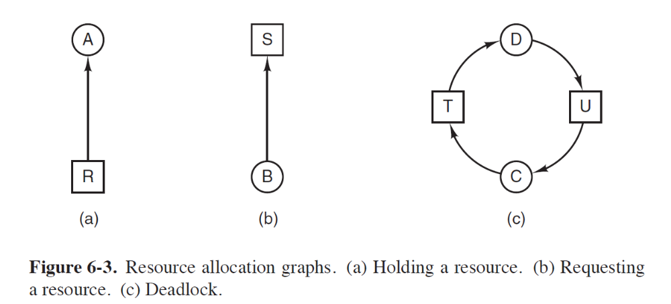
Deadlock Modeling
The graphs have two kinds of nodes: processes, shown as circles, and resources, shown as squares. A directed arc from a resource node (square) to a process node (circle) means that the resource has previously been requested by, granted to, and is currently held by that process. In Fig. 6-3(a), resource R is currently assigned to process A.
A directed arc from a process to a resource means that the process is currently blocked waiting for that resource. In Fig. 6-3(b), process B is waiting for resource
S. In Fig. 6-3(c) we see a deadlock: process C is waiting for resource T, which is currently held by process D. Process D is not about to release resource T because
it is waiting for resource U, held by C. Both processes will wait forever.

Slide 11
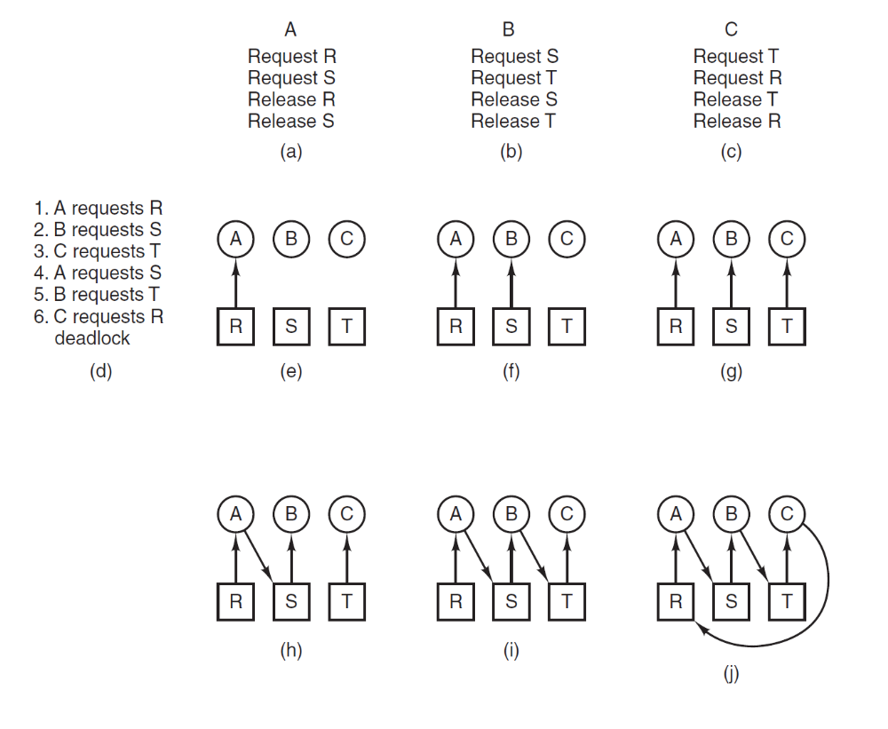
Deadlock Modeling

Slide 12
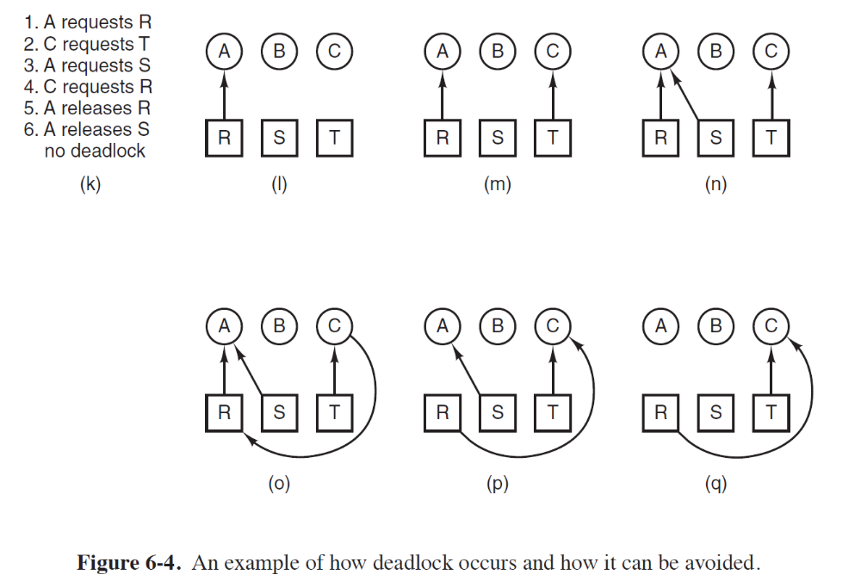
Deadlock Modeling

Slide 13
Deadlock Modeling
Strategies for dealing with deadlocks:
Just ignore the problem.
Detection and recovery. Let deadlocks occur, detect them, take action.
Dynamic avoidance by careful resource allocation.
Prevention, by structurally negating one of the four required conditions.

